Slide 1
My First R Package
Harry Smith

Slide 2
Sounds scary

Slide 3
Motivation
Reproducibility
Documentation
Code sharing
Work efficiency

Slide 4
Context
Trying to stick to functional coding for transcriptome reconstruction project
Writing a lot of functions
All these functions are in one script
Allmyfunctions.R
You may have many scripts for many functions
If I change projects, I will need to copy scripts to be sourced

Slide 5
What you will need
Rstudio
The functions you wish to include in the package
Packages (Dude, that’s meta!)
Optional (but highly recommended)
Repository on GitHub

Slide 6
Step 0: Load packages
install.packages("devtools")
library("devtools")
devtools::install_github("klutometis/roxygen")
library(roxygen2)

Slide 7
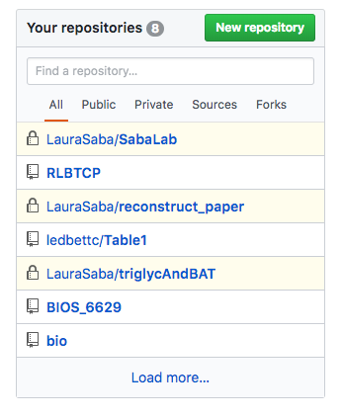
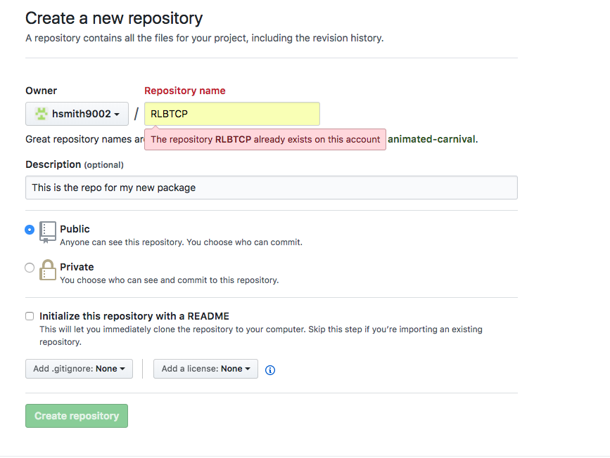
Create repository

Slide 8
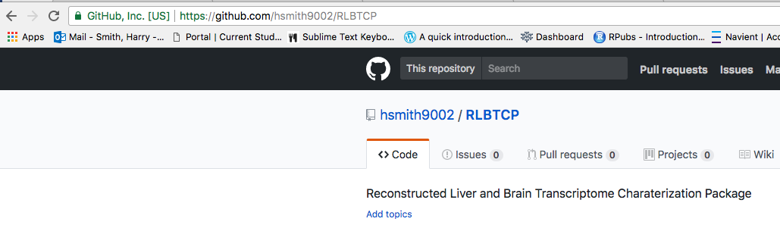
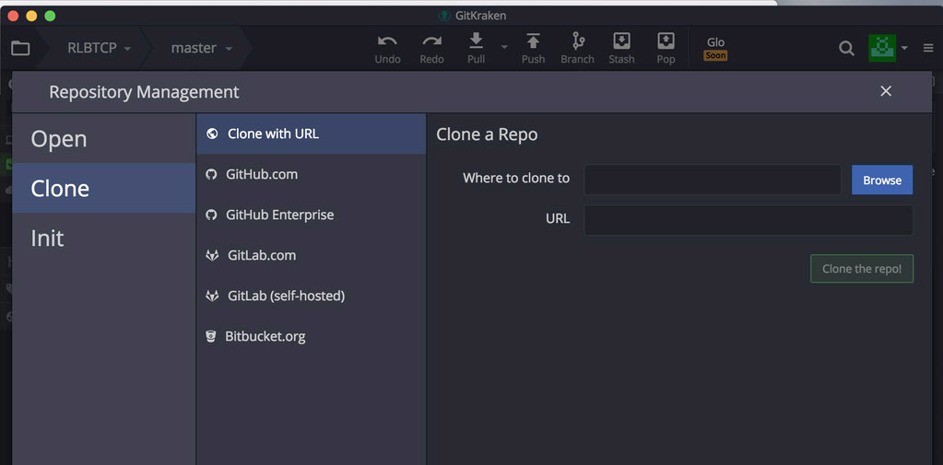
Clone repository using GitKraken

Slide 9
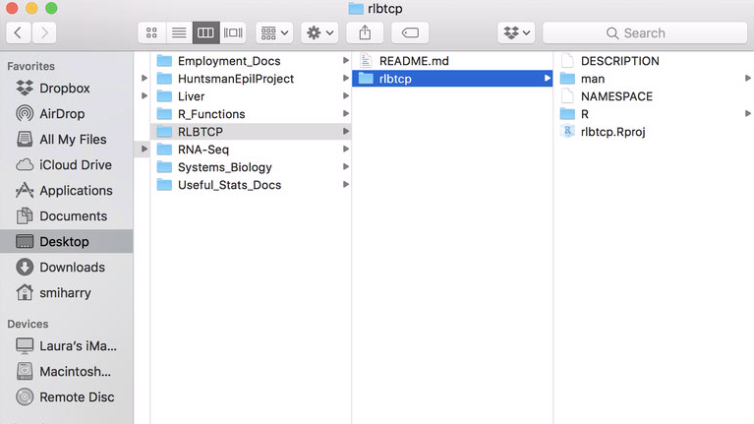
Step 1: Create package directory
setwd("/Users/smiharry/Desktop/Saba_Lab/RLBTCP")
create("rlbtcp")
Directory that you just cloned

Slide 10
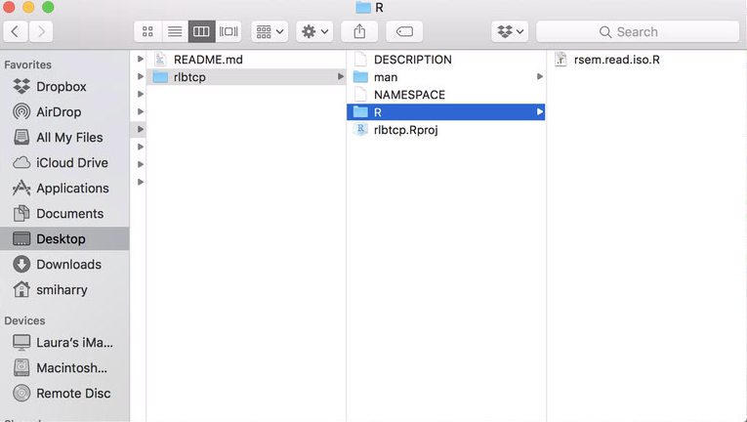
Step 2: Add functions

Slide 11
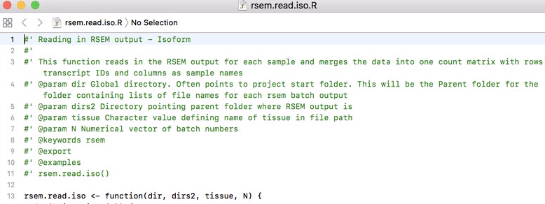
Step 3: Documentation for function

Slide 12
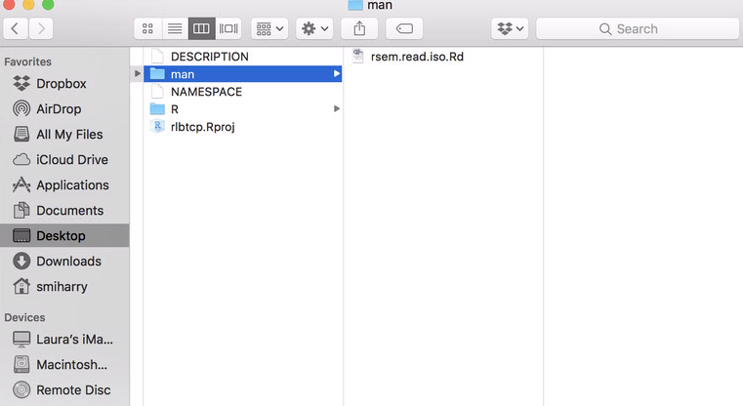
Step 4: Process your documentation
setwd("./rlbtcp")
document()

Slide 13
Step 5: Install
setwd(“/Users/smiharry/Desktop/Saba_Lab/RLBTCP")
install(”rlbtcp")

Slide 14
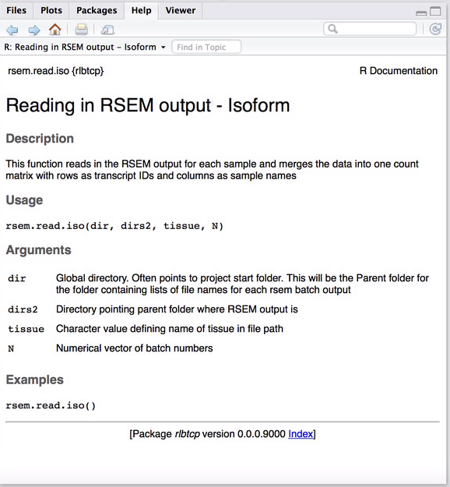
library(rlbtcp)
?rsem.read.iso

Slide 15
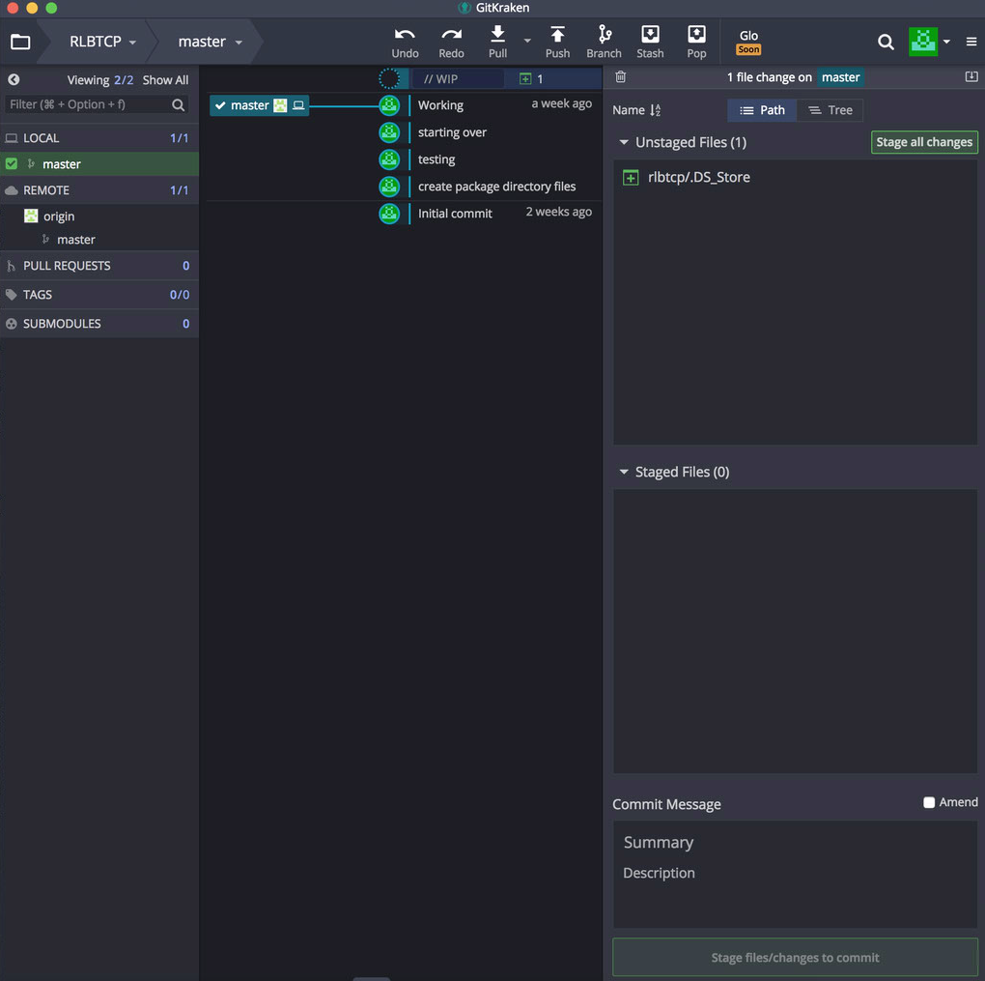
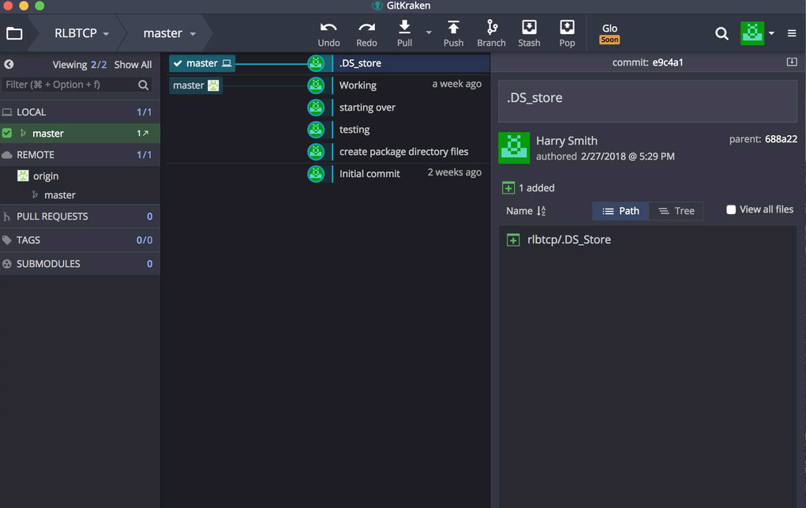
Final step: Commit and push to repo

Slide 16
Now what?
You don’t have to stop at 1 function
Add as many as you like
Can I add a function after I have created the package?
Yup!
What if all my functions are in one script?
This will work as long as you use the documentation format

Slide 17
You did it! Not so scary after all

